Slide 1
Artificial Intelligence as a Tool for Missing Persons Identification

Slide 2
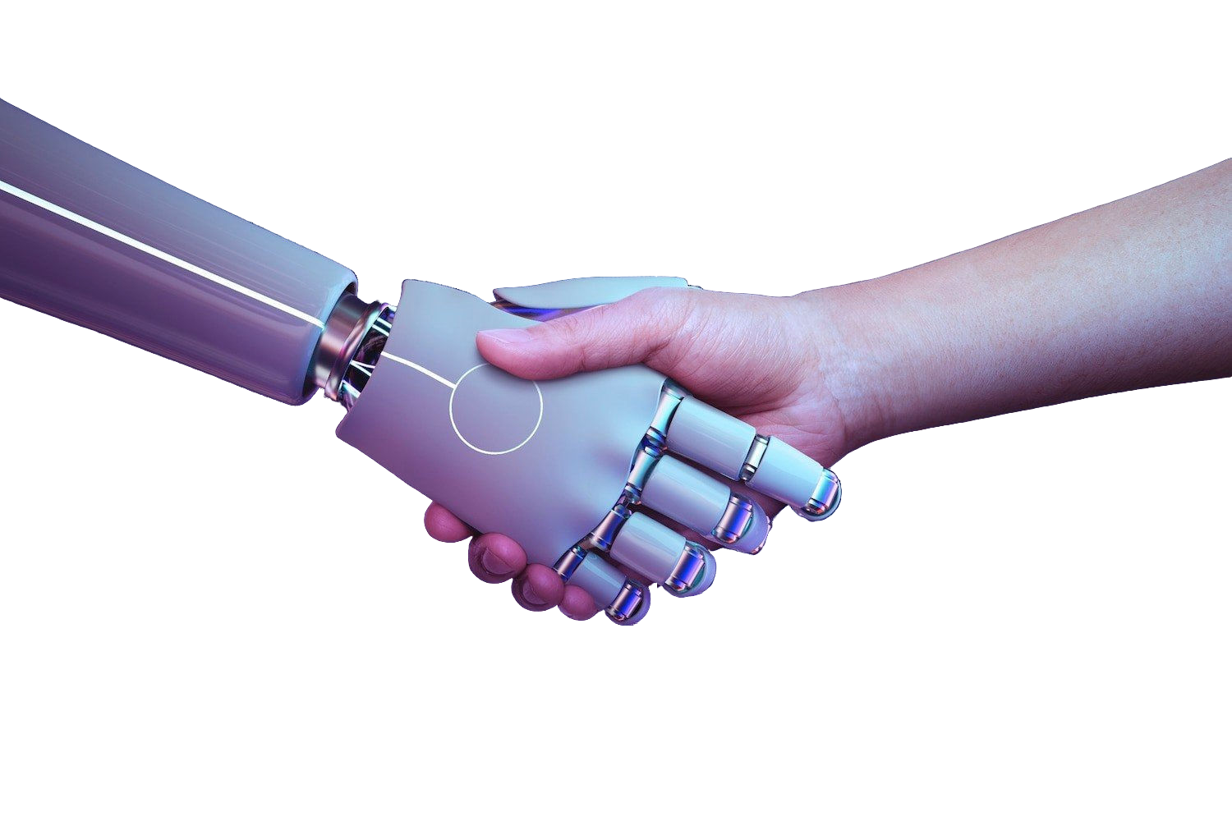
Introduction
Artificial Intelligence (AI) has revolutionized various industries, including the search and rescue sector. AI technology offers advanced capabilities for locating missing individuals by analyzing vast amounts of data and utilizing sophisticated algorithms. This presentation will explore the potential of AI in addressing the challenges of finding missing persons.

Slide 3
Problem Statement
Purpose: The project focuses on identifying and scaling face encoding algorithms and identifying if a person is missing or has been found somewhere recently or not.
Segmentation/Steps: Face recognition technology has numerous applications, and its greatest benefit is its ability to locate missing individuals. In order to facilitate the process of locating the missing person, we propose to set up an operation that will be accessible to volunteers and allow us to locate the missing person quickly.

Slide 4

Relevance of Our Project
In the world, a countless
number of day which mentally
people are includes challenged,
missing kiddies,
every teens,
old-aged people with
Alzheimer's, etc. Most of them remain untraced. The motivation behind our project is to get useful information from
the data samples we variety of sources and
collect from a make use of
different Python libraries and machine learning algorithms to analyze the collected data and detect(with some accuracy) if a specific person is missing or was seen recently.

Slide 5
Facial Recognition and Biometric Data
We will be using 2 models for further face recognition process.
1.dlib_face_recognition_resnet_model_v1.dat 2.shape_predictor_68_face_landmarks.dat

Slide 6

Training and Prediction
The process of finding a missing person can be quite lengthy and time-consuming when done manually, as it involves launching an FIR at the police station.
Existing applications that provide a database of missing persons often fail to provide sufficient information about the individual's appearance.
In certain public locations, such as amusement parks, RFID chips are used to locate people. To address these issues, we propose a new system that includes an image of the missing person to aid in their search.

Slide 7
Ethical and Privacy Considerations
While AI offers significant advantages in locating missing individuals, ethical and privacy concerns must be carefully addressed. The use of biometric data and surveillance technologies should adhere to stringent ethical guidelines to safeguard the privacy and rights of the individuals being searched for.

Slide 8
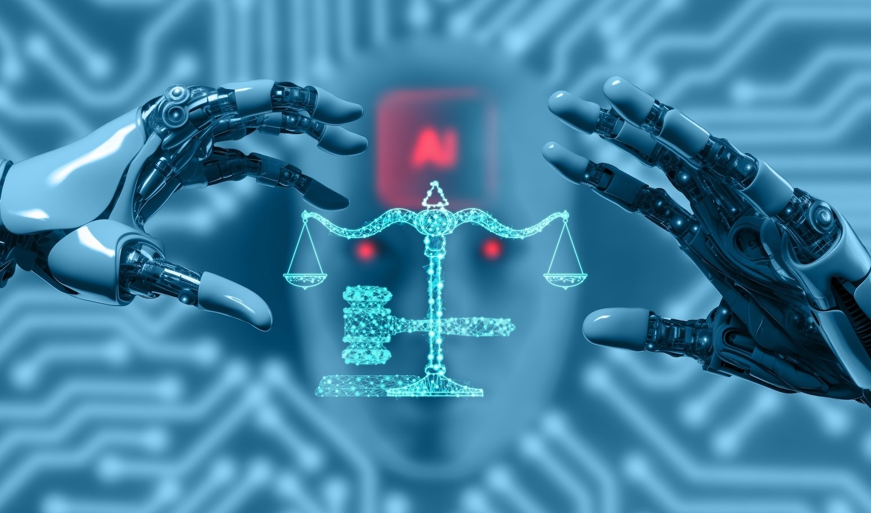

Methods, Tools & Techniques
Programming Language: Python, HTML,CSS
IDE : VScode
Libraries: Tensorflow, Numpy, Dlib, OpenCV
Datasets: Pre-Trained models saved as dat files

Slide 9

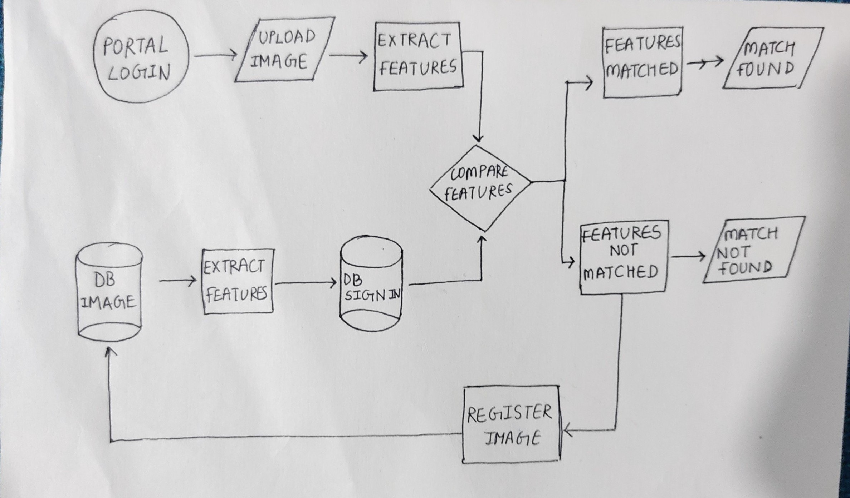
Model Architecture
We employ dlib facial landmark detection to identify the unique facial key points of a missing individual. This approach utilizes one-shot learning and generates approximately 68 distinct points for a face. These points are represented as floating- point values with an accuracy of approximately 8 decimal places.

Slide 10
Conclusion
This approach enables rapid identification of missing individuals. Instead of manually examining a single picture database, our well-designed face recognition system quickly performs the task.

Slide 11
Thanks!

